Slide 1
Managerial Accounting
Lecture 03: Managerial Accounting (Concepts & Principles)
Chapter
20
Masud Jahan
Department of Science and Humanities
Military Institute of Science and Technology

Slide 2
Cost Vs Expense
Cost is the sacrifice of resources incurred on or attributable to acquisition of a specific objective
Expenses are the costs of assets and services used up in the process of earning revenue.
<number>/38

Slide 3
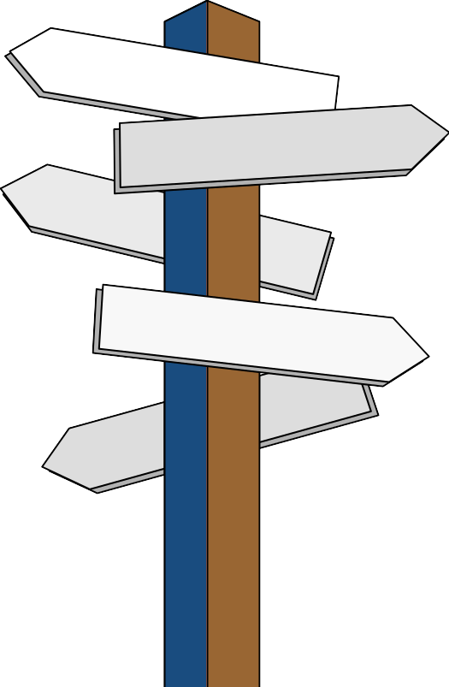
Classification Of Costs
By Traceability
By association
By Behavior
By controllability
By relevance
<number>/38

Slide 4

Learning Objective
To classify costs by traceability
with jobs, products, or services
LO1
<number>/38
Notes:
Learning objective number 1 is to explain the purpose of adjusting entries.

Slide 5
Cost Classifications by traceability
Direct costs
Costs that can be
easily and conveniently traced to a unit of product or other cost objective.
Would not be incurred if the product or activity were discontinued.
Examples: direct material and direct labor
Indirect costs
Costs cannot be easily and conveniently traced to a unit of product or other cost object.
Would be incurred even if the product or activity were discontinued.
Example: indirect material and indirect labor
<number>/38
Notes:
Sometimes you’ll hear costs referred to as direct costs and indirect costs. Direct costs refer to direct materials and direct labor. Indirect costs refer to manufacturing overhead.

Slide 6
Learning Objective
To classify costs by activity
to which they associate
LO2
<number>/38
Notes:
Learning objective number 1 is to explain the purpose of adjusting entries.

Slide 7
Cost Classifications by association
costs are classified into four categories.
i) Manufacturing Costs
ii) Administrative Costs
iii) Selling Costs
iv) Distribution Costs
<number>/38

Slide 8
Manufacturing Costs
Manufacturing costs are those costs related to factory operations which are essential to the completion of the product.
It includes direct material costs, direct labor costs and manufacturing overheads.
<number>/38

Slide 9
Administrative Costs
Administrative costs includes all those costs incurred on the general administration and control of the firm.
Examples of such costs are : salaries of the office staff, rent of the office building, depreciation and repairs of the office furniture etc.
<number>/38

Slide 10
Selling Costs
Selling costs are those costs which are incurred in connection with the sale of goods.
Some examples of such costs are : Cost of warehousing, advertising, salesmen salaries etc.
<number>/38

Slide 11
Distribution Costs
Distribution costs are those costs which are incurred on dispatch of finished products to customer including transportation.
Examples of such costs are: packing, carriage, insurance, freight outwards, etc.
<number>/38

Slide 12
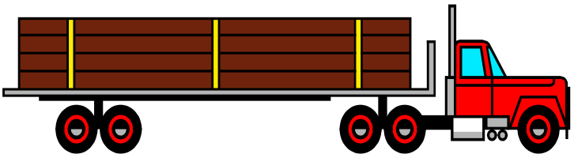




Components of Manufacturing Cost
The cost to produce a unit of product includes:
  Direct material
  Direct labor
  Manufacturing
  overhead
Lightbulbs
Supplies
<number>/38
Notes:
Managers control costs by managing activities. Understanding the relationship between activities and costs will result in better decisions to control costs. Manufacturing costs include direct material, direct labor, and manufacturing overhead.

Slide 13
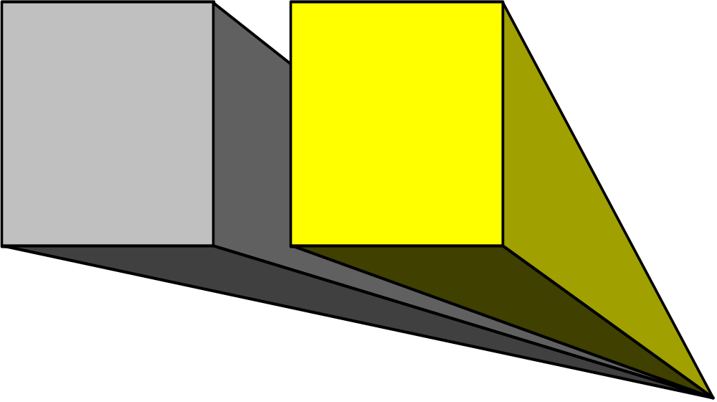
Direct Materials
Raw materials & component parts that become an integral part of finished products.
Can be traced directly and conveniently to unit of product.
If materials cannot be traced directly to products, the materials are considered indirect and are part of manufacturing overhead.
<number>/38
Notes:
Part I
Direct materials can be separately and readily traced to the individual units of product being manufactured. Direct materials are sufficiently significant in amount to justify the separate tracing.
Part II
Some materials used in the manufacturing process cannot be directly traced to individual units of output. These indirect materials are considered part of manufacturing overhead.

Slide 14

Direct Labor
Includes the payroll cost of direct workers.
Those employees who work directly on the goods being manufactured.
The cost of employees who do not work directly on the goods is considered indirect labor and is part of manufacturing overhead.
<number>/38
Notes:
Part I
Direct labor is the effort of employees who actually convert materials into a finished product. Direct labor costs are the wages of direct labor employees. Direct labor costs can be separately and readily traced to the individual units of product being manufactured.
Part II
The labor costs of some employees are considered indirect labor when we cannot trace the labor costs directly to a particular unit of output, but the employee is needed to keep the production process on track. For example, the cost of maintenance employees who work on the equipment used to produce our product is considered indirect labor. Indirect labor is part of manufacturing overhead.

Slide 15
Manufacturing Overhead
All manufacturing costs other than direct materials and direct labor.
Includes:
Indirect materials.
Indirect labor.
Machinery and equipment repair costs.
Cost of regulatory compliance.
Lightbulbs
Supplies
Does not include selling or general and administrative expenses.
<number>/38
Notes:
Part I
Besides indirect materials and indirect labor, we have other manufacturing overhead costs. Such costs include power for the factory equipment, depreciation on factory equipment, and the like.
Part II
Selling and general expenses and administrative expenses are considered period costs and are not charged to the product. These expenses cannot be part of manufacturing overhead.

Slide 16


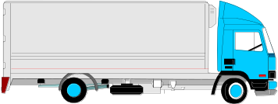

Flow of Physical Goods in Production
Raw Materials Purchased
Direct Materials Cost
Finished Goods
Direct Labor
Manufacturing Overhead
Goods Sold
MegaLoMart
<number>/38
Notes:
A company purchases direct materials. Direct materials, direct labor, and manufacturing overhead are charge to the product. When the product is complete it is transferred to finished goods inventory. When the goods are sold, they are removed from finished goods inventory and charged to cost of goods sold.

Slide 17
Accounting for Manufacturing Operations
Manufacturing costs are often
combined as follows:
Direct
Materials
Direct
Labor
Manufacturing Overhead
Prime
Cost
Conversion
Cost
<number>/38
Notes:
Direct labor and direct materials are often called the prime costs of manufacturing. Both direct materials and direct labor can be traced to units of production.
Direct labor and manufacturing overhead are called conversion costs. Direct labor and manufacturing overhead are the costs we incur to convert the direct materials into finished goods.

Slide 18
Learning Objective
To classify costs by
behavior with activity level
LO3
<number>/38
Notes:
Learning objective number 1 is to explain the purpose of adjusting entries.

Slide 19
Cost Classifications by Behavior
Cost Behavior
How a cost will react to
changes in the level of business activity.
  Total variable costs change
  when the level of activity changes.
  Total fixed costs remain unchanged
  when the level of activity changes.
<number>/38

Slide 20
Typical Examples
Typical variable costs
Raw materials
Direct labor
Factory utilities
Sales commissions
Shipping costs
Typical fixed costs
Real estate taxes
Factory rent
Supervisory salaries
Workers’ welfare cost
Depreciation
<number>/38

Slide 21

Total Variable Cost
A variable cost is one that changes in total
in proportion to changes in the volume of activity.
Total electricity bill
is based on how many units you use.
Total Electricity Bill
Units Used
<number>/38

Slide 22
Variable Cost Per Unit
On a per unit basis, a variable cost
remains constant over a wide range of activity.
The cost per unit electricity used is constant.
For example, Tk 10 per unit .
Per Unit
Electricity Charge
Units Used
<number>/38

Slide 23

Total Fixed Cost
A fixed cost is one that remains constant in total even when the volume of activity changes.
Monthly factory rent does not change when
production level is more or less.
Monthly Factory Rent
Units produced
<number>/38

Slide 24
Fixed Cost Per Unit
On a per unit basis, a fixed cost changes
as the volume of activity changes.
Factory rent per unit produced
declines as more units are produced .
Per unit
factory rent
Units produced
<number>/38

Slide 25

Semi variable Cost
A semi variable or
mix cost has both fixed and variable
components.
Consider
Land Phone Bill example.
<number>/38

Slide 26


Semi variable Cost
Y
Total semi variable cost
Variable
Utility Charge
Total Utility Cost
Fixed Monthly
Utility Charge
X
Activity (Minutes Talked)
<number>/38

Slide 27
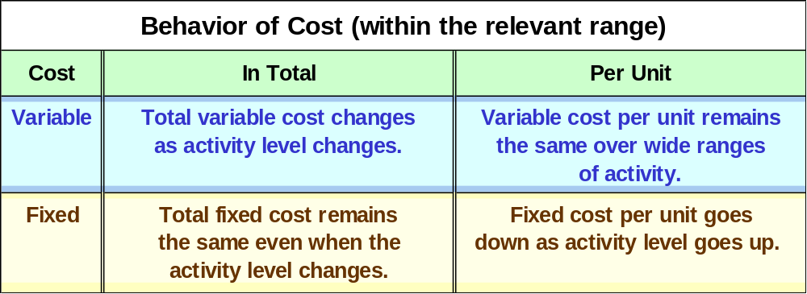
Cost Classifications for Predicting Cost Behavior
<number>/38

Slide 28
Learning Objective
To classify costs
by controllability
LO5
<number>/38
Notes:
Learning objective number 1 is to explain the purpose of adjusting entries.

Slide 29
Cost Classifications by controllability
Controllable costs are
Uncontrollable costs
those costs which can be controlled by a specified person or a
are those costs which cannot be controlled or influenced by a specified
level of management
person of an enterprise
Example: Material cost
Example: Factory rent
<number>/38
Notes:
4
The accrual basis dictates that revenues be recognized when earned and expenses be recognized when incurred. The accrual basis of accounting is considered to be in compliance with generally accepted accounting principles, GAAP.
Every adjusting entry involves a revenue or expense and an asset or liability.

Slide 30
Learning Objective
To classify costs by
relevance to
decision-making
LO6
<number>/38
Notes:
Learning objective number 1 is to explain the purpose of adjusting entries.

Slide 31
Cost Classifications by relevance
Sunk costs
Costs already incurred that can not be avoided or changed.
Irrelevant to future decision making.
Examples: Equipment previously purchased.
Out-of-pocket costs
Costs require a future outlay of cash.
Relevant for future decision making.
Example: Future purchase of equipment
<number>/38
Notes:
Sometimes you’ll hear costs referred to as direct costs and indirect costs. Direct costs refer to direct materials and direct labor. Indirect costs refer to manufacturing overhead.

Slide 32
End of Lecture 03
THANK YOU ALL…

